Slide 1



Language and sensorimotor simulation in conceptual processing: Multilevel analysis and statistical power Pablo Bernabeu
osf.io/97u5c

Slide 2

Hyggelig å møte dere!
Min bane
BA English
Research Master Psycholinguistics
PhD Psycholinguistics, on conceptual processing (the understanding of words)
Starting soon: Postdoc on the acquisition and use of two and more languages

Slide 3
How do people understand the meaning of words?

Slide 4
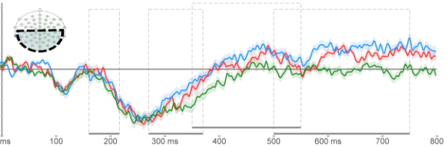
Terminology
From Bernabeu et al. (2017)
Levels of processing:

Slide 5
Terminology
From Bernabeu et al. (2017)
Levels of processing:
Lexical

Slide 6
Terminology
From Bernabeu et al. (2017)
Levels of processing:
Lexical
Semantic

Slide 7
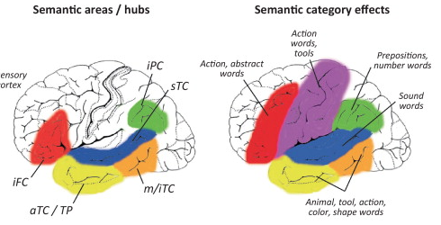
Terminology
Lexical
Semantic
Semantic processing systems / sources of information
S
c
From Pulvermüller (2013)

Slide 8
Terminology
Lexical
Semantic
Semantic processing systems / sources of information
LINGUISTIC
Distributional
S
c
From Pulvermüller (2013)

Slide 9
Terminology
Lexical
Semantic
Semantic processing systems / sources of information
LINGUISTIC EMBODIED
Distributional
Simulation
Situated
Grounded
S
c
From Pulvermüller (2013)

Slide 10
Distributional semantics
DOG
PARADOX
GRAB
pet irony take
walk text force
cute surprise coffee

Slide 11
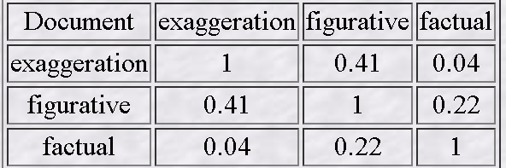
Distributional semantics
DOG
PARADOX
GRAB
pet irony take
walk text force
cute surprise coffee
Latent Semantic Analysis (http:// lsa.colorado.edu)

Slide 12
Distributional semantics
DOG
PARADOX
GRAB
pet irony take
walk text force
cute surprise coffee
Latent Semantic Analysis (http:// lsa.colorado.edu)
CORPUS: Populations (Louwerse & Zwaan, 2009)
RT: animals, body, geography (Lund & Burgess, 1996) *
BRAIN: Voxel-level neural activation predicted
by distributional statistics (Mitchell et al., 2008)

Slide 13
Distributional semantics
DOG
PARADOX
GRAB
pet irony take
walk text force
cute surprise coffee
Latent Semantic Analysis (http:// lsa.colorado.edu)
CORPUS: Populations (Louwerse & Zwaan, 2009)
RT: animals, body, geography (Lund & Burgess, 1996) *
BRAIN: Voxel-level neural activation predicted
by distributional statistics (Mitchell et al., 2008)
* Symbol-grounding problem

Slide 14
Distributional semantics
DOG
PARADOX
GRAB
pet irony take
walk text force
cute surprise coffee
Personal & external
EXPERIENCE
Latent Semantic Analysis (http:// lsa.colorado.edu)
CORPUS: Populations (Louwerse & Zwaan, 2009)
RT: animals, body, geography (Lund & Burgess, 1996) *
BRAIN: Voxel-level neural activation predicted
by distributional statistics (Mitchell et al., 2008)
* Symbol-grounding problem

Slide 15





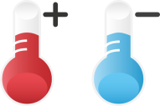
Distributional semantics
Embodied cognition
DOG
PARADOX
GRAB
pet irony take
walk text force
cute surprise coffee
GRAB
PARADOX
DOG
Personal & external
EXPERIENCE
Latent Semantic Analysis (http:// lsa.colorado.edu)
CORPUS: Populations (Louwerse & Zwaan, 2009)
RT: animals, body, geography (Lund & Burgess, 1996) *
BRAIN: Voxel-level neural activation predicted
by distributional statistics (Mitchell et al., 2008)
* Symbol-grounding problem

Slide 16

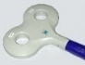
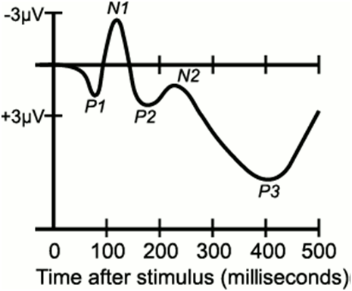
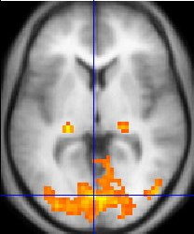
Distributional semantics
Embodied cognition
DOG
PARADOX
GRAB
pet irony take
walk text force
cute surprise coffee
GRAB
PARADOX
DOG
Personal & external
EXPERIENCE
Latent Semantic Analysis (http:// lsa.colorado.edu)
EMOTIONAL Kousta et al. (2011) * YES/NO
MOTOR Willems et al. (2011)
SENSORY Hald et al. (2011)
Simmons et al. (2007)
CORPUS: Populations (Louwerse & Zwaan, 2009)
RT: animals, body, geography (Lund & Burgess, 1996) *
BRAIN: Voxel-level neural activation predicted
by distributional statistics (Mitchell et al., 2008)
* Symbol-grounding problem
‘Green’

Slide 17
Distributional semantics
Embodied cognition
DOG
PARADOX
GRAB
pet irony take
walk text force
cute surprise coffee
GRAB
PARADOX
DOG
Personal & external
EXPERIENCE
Latent Semantic Analysis (http:// lsa.colorado.edu)
EMOTIONAL Kousta et al. (2011) * YES/NO
MOTOR Willems et al. (2011)
SENSORY Hald et al. (2011)
Simmons et al. (2007)
(Hickok, 2014;
Willems & Francken, 2012;
Mahon & Caramazza, 2008)
CORPUS: Populations (Louwerse & Zwaan, 2009)
RT: animals, body, geography (Lund & Burgess, 1996) *
BRAIN: Voxel-level neural activation predicted
by distributional statistics (Mitchell et al., 2008)
* Symbol-grounding problem
‘Green’
* Causality question

Slide 18
Distributional semantics
Embodied cognition
DOG
PARADOX
GRAB
GRAB
PARADOX
DOG
pet irony take
walk text force
cute surprise coffee
Occam’s
razor
Latent Semantic Analysis (http:// lsa.colorado.edu)
EMOTIONAL Kousta et al (2011) * YES/NO
MOTOR Willems et al (2011)
SENSORY Hald et al (2011)
Simmons et al (2007)
(Hickok, 2014; Willems & Francken, 2012; Mahon & Caramazza, 2008)
CORPUS: Populations (Louwerse & Zwaan, 2009)
RT: animals, body, geogra. (Lund & Burgess, 1996) *
BRAIN: Voxel-level neural activation predicted by distributional statistics (Mitchell et al, 2008)
! Symbol-grounding problem
‘Green’
! Causality question

Slide 19
Distributional semantics
Embodied cognition
DOG
GRAB
DOG
GRAB
GRAB
PARADOX
DOG
PARADOX
GRAB
PARADOX
DOG
PARADOX
pet irony take
walk text force
cute surprise coffee
Occam’s
razor:
Why not
a single system?
Latent Semantic Analysis (http:// lsa.colorado.edu)
EMOTIONAL Kousta et al (2011) * YES/NO
MOTOR Willems et al (2011)
SENSORY Hald et al (2011)
Simmons et al (2007)
(Hickok, 2014; Willems & Francken, 2012; Mahon & Caramazza, 2008)
CORPUS: Populations (Louwerse & Zwaan, 2009)
RT: animals, body, geogra. (Lund & Burgess, 1996) *
BRAIN: Voxel-level neural activation predicted by distributional statistics (Mitchell et al, 2008)
! Symbol-grounding problem
‘Green’
! Causality question

Slide 20
Language

Slide 21
Language
Situated simulation

Slide 22
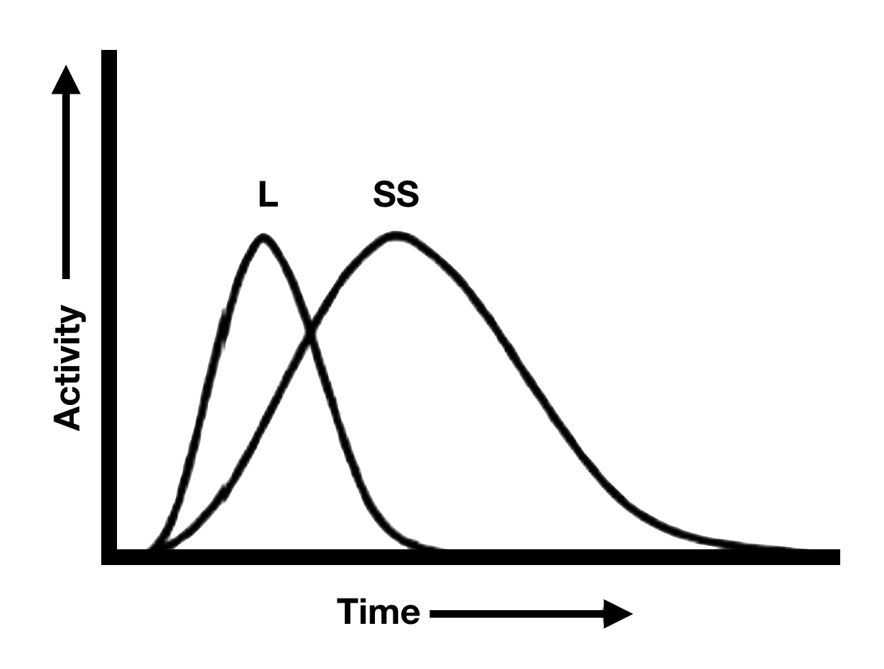
Adapted from Barsalou et al. (2008)
Language
Situated simulation
Activity
Time

Slide 23
Causality (also known as functional role)

Slide 24
Causality (also known as functional role)
Sensorimotor simulation: cause or result of comprehension?
- Transcranial magnetic stimulation
- Online time course (EEG/MEG)
- Scrutiny of the interplay between language and simulation at several levels of the experimental structure—e.g., individuals, words, tasks, and languages.

Slide 25
Study 1: Contribution to multi-lab project

Slide 26
Psychological Science Accelerator (Project 002)
Openly sourced projects, from preregistration through testing, etc.
Aims: more robust analysis, larger samples
Open for submitting a project or collaborating in existing projects
Materials and procedure created by lead lab, used by all others
(translated to each language)

Slide 27
Object orientation effect (classic embodiment effect) Group replication (Psychological Science Accelerator)
Zwaan, Stanfield, and Yaxley (2002)
Sentence-picture verification

Slide 28
Object orientation effect Group replication (Psychological Science Accelerator)
Zwaan, Stanfield, and Yaxley (2002)
Sentence-picture verification
He saw the eagle in the sky

Slide 29
Object orientation effect Group replication (Psychological Science Accelerator)
Zwaan, Stanfield, and Yaxley (2002)
Sentence-picture verification
He saw the eagle in the sky

Slide 30

Object orientation effect Group replication (Psychological Science Accelerator)
Zwaan, Stanfield, and Yaxley (2002)
Sentence-picture verification: ‘Was this object in the sentence?’
[congruent]

Slide 31

Object orientation effect Group replication (Psychological Science Accelerator)
Zwaan, Stanfield, and Yaxley (2002)
Sentence-picture verification: ‘Was this object in the sentence?’
[INcongruent]

Slide 32
Object orientation effect Group replication (Psychological Science Accelerator)
Zwaan, Stanfield, and Yaxley (2002)
Sentence-picture verification: ‘Was this object in the sentence?’
[congruent] He saw the eagle in the sky
[INcongruent]
ORIGINAL RESULTS: Faster responses for congruent trials

Slide 33
Object orientation effect Group replication (Psychological Science Accelerator)
Zwaan, Stanfield, and Yaxley (2002) replicated across 14 languages (NEng = 1,900)
Sentence-picture verification: ‘Was this object in the sentence?’
[congruent] He saw the eagle in the sky
[INcongruent]
ORIGINAL RESULTS: Faster responses for congruent trials.
Interpretation: Mental simulation of orientation while reading

Slide 34
Object orientation effect Group replication (Psychological Science Accelerator)
Zwaan, Stanfield, and Yaxley (2002) replicated across 14 languages (NEng = 1,900)
Sentence-picture verification: ‘Was this object in the sentence?’
[congruent] He saw the eagle in the sky
[INcongruent]
ORIGINAL RESULTS: Faster responses for congruent trials.
Interpretation: Mental simulation of orientation while reading
ADDITION: Individual differences in spatial cognition,
particularly mental rotation

Slide 35
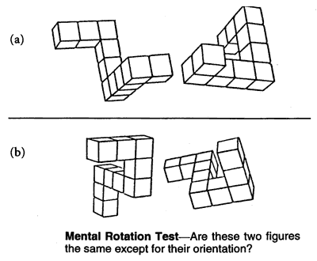
Object orientation effect Group replication (Psychological Science Accelerator)
Zwaan, Stanfield, and Yaxley (2002) replicated across 14 languages (NEng = 1,900)
Sentence-picture verification: ‘Was this object in the sentence?’
[congruent] He saw the eagle in the sky
[INcongruent]
ORIGINAL RESULTS: Faster responses for congruent trials.
Interpretation: Mental simulation of orientation while reading
ADDITION: Individual differences in spatial cognition,
particularly mental rotation

Slide 36
Object orientation effect Group replication (Psychological Science Accelerator)
Zwaan, Stanfield, and Yaxley (2002) replicated across 14 languages (NEng = 1,900)
Sentence-picture verification: ‘Was this object in the sentence?’
[congruent] He saw the eagle in the sky
[INcongruent]
ORIGINAL RESULTS: Faster responses for congruent trials.
Interpretation: Mental simulation of orientation while reading
ADDITION: Individual differences in mental rotation,
18 languages
From mercercognitivepsychology.pbworks.com

Slide 37
Results of Study 1
No effect of object orientation across 18 languages,
even despite N > 1,000 in English.
No interaction with mental rotation.
Challenges ahead:
theoretical basis for crosslinguistic research on this topic;
sufficient and equal sample sizes in all languages
(calling for statistical power analyses).

Slide 38
Study 2: Novel analysis of existing data sets

Slide 39
Study 2: Novel analysis of existing data sets
Continuing topics from Study 1:
Sensorimotor simulation
Individual differences
Statistical power
New in Study 2:
Language-based information in words
Individual differences in vocabulary size
Regression-based analysis with conservative, fixed and random effects
Systematic power analysis across three studies

Slide 40
Study 2: Novel analysis of existing data sets
Four main motivations
Occam’s razor: Why so many systems?
Scrutiny of theory at multiple levels of the experimental structure
Inconclusive findings (see next)

Slide 41
Inconclusive findings
Some findings have suggested that higher-vocabulary participants are more sensitive to language-based information—as reflected in greater semantic priming (Yap et al., 2017)—, in contrast to other findings (Yap et al., 2009).
Some studies have suggested that the language system is activated before the embodiment system (Lam et al., 2015; Louwerse & Connell, 2011), whereas a recent study suggested that this pattern does not hold in the lexical decision task (Petilli et al., 2021).
Some evidence has suggested that female participants draw on the language system more prominently than males (Burman et al., 2008; Hutchinson & Louwerse, 2013; Jung et al., 2019; Ullman et al., 2008), whereas other research has suggested that this difference is negligible in the general population (Wallentin, 2020).

Slide 42
Study 2: Novel analysis of existing data sets
Four main motivations
Occam’s razor: Why so many systems?
Scrutiny of theory at multiple levels of the experimental structure
Inconclusive findings
Scarce statistical power in most studies

Slide 43
Study 2: Novel analysis of existing data sets
Semantic priming: Study 2.1
Semantic decision: Study 2.2
Lexical decision: Study 2.3

Slide 44
Study 2: Novel analysis of existing data sets
Semantic priming: prime → target → Classifying target as word or nonword
Part of the data from Hutchison et al. (2013)
Semantic decision: single word → Classifying word as abstract or concrete
Data from Pexman et al. (2018)
Lexical decision: single word → Classifying stimulus as word or nonword
Data from Balota et al. (2007)

Slide 45
Study 2: Novel analysis of existing data sets
Semantic priming (Study 2.1)
Very large number of RTs: 345,666
Semantic decision (Study 2.2)
Not as many RTs: 254,140
Lexical decision (Study 2.3)
Fewest RTs: 19,828
Issue: only 2 participants per word on average

Slide 46
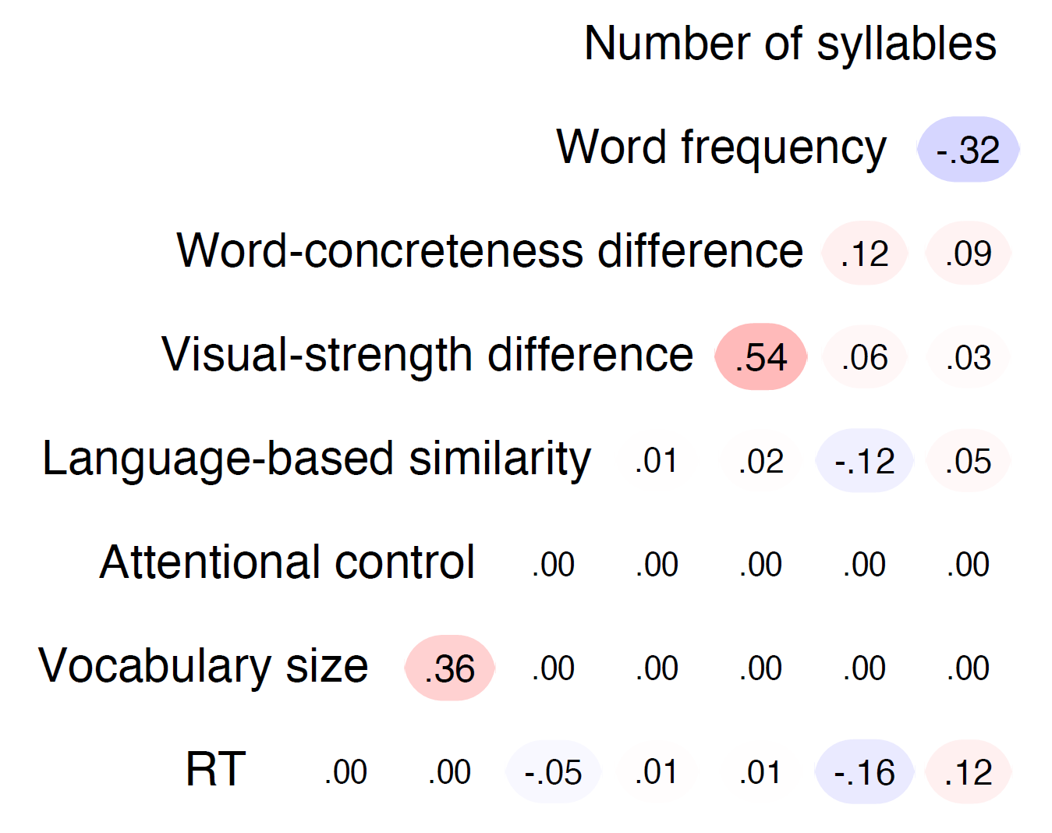

Slide 47
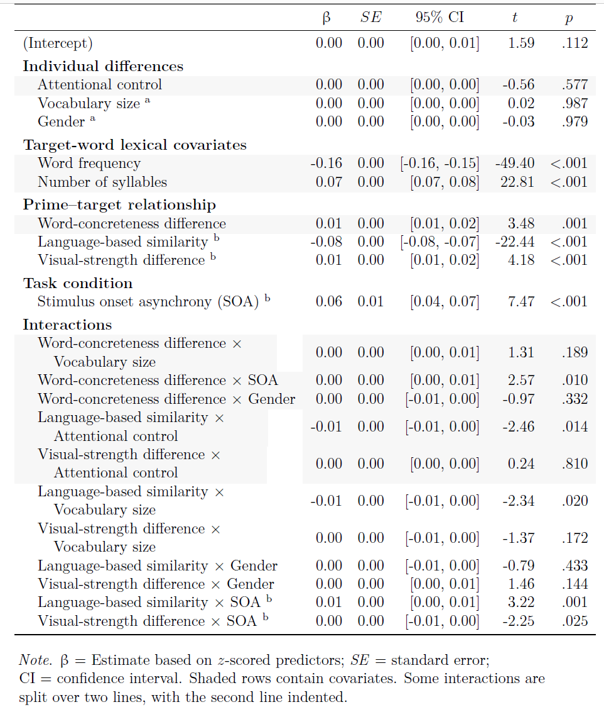

Slide 49
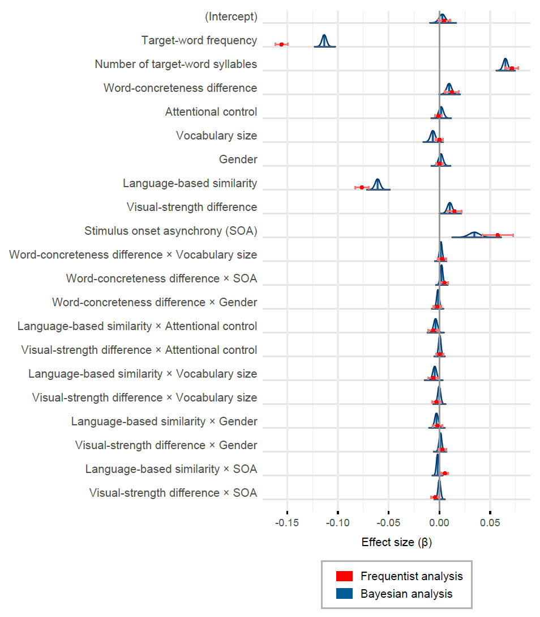

Slide 50
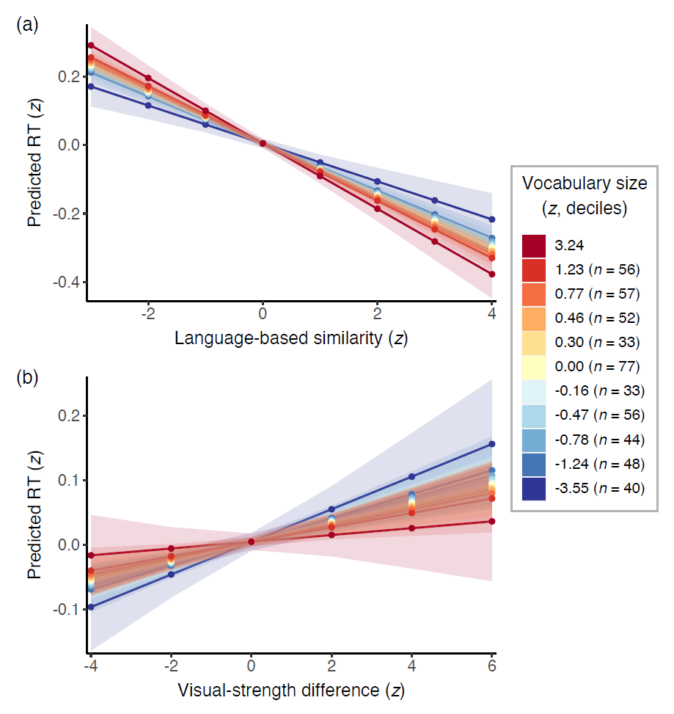

Slide 51
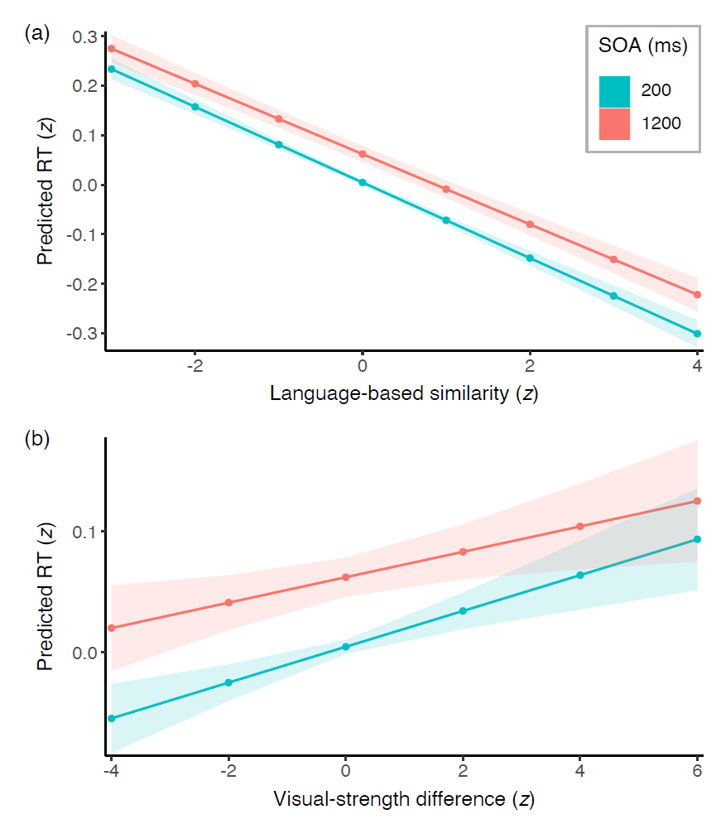

Slide 52
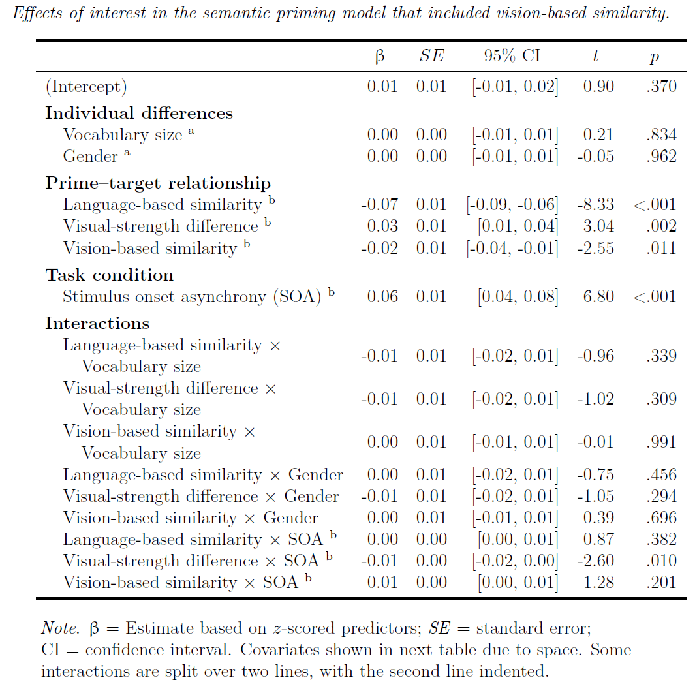

Slide 53
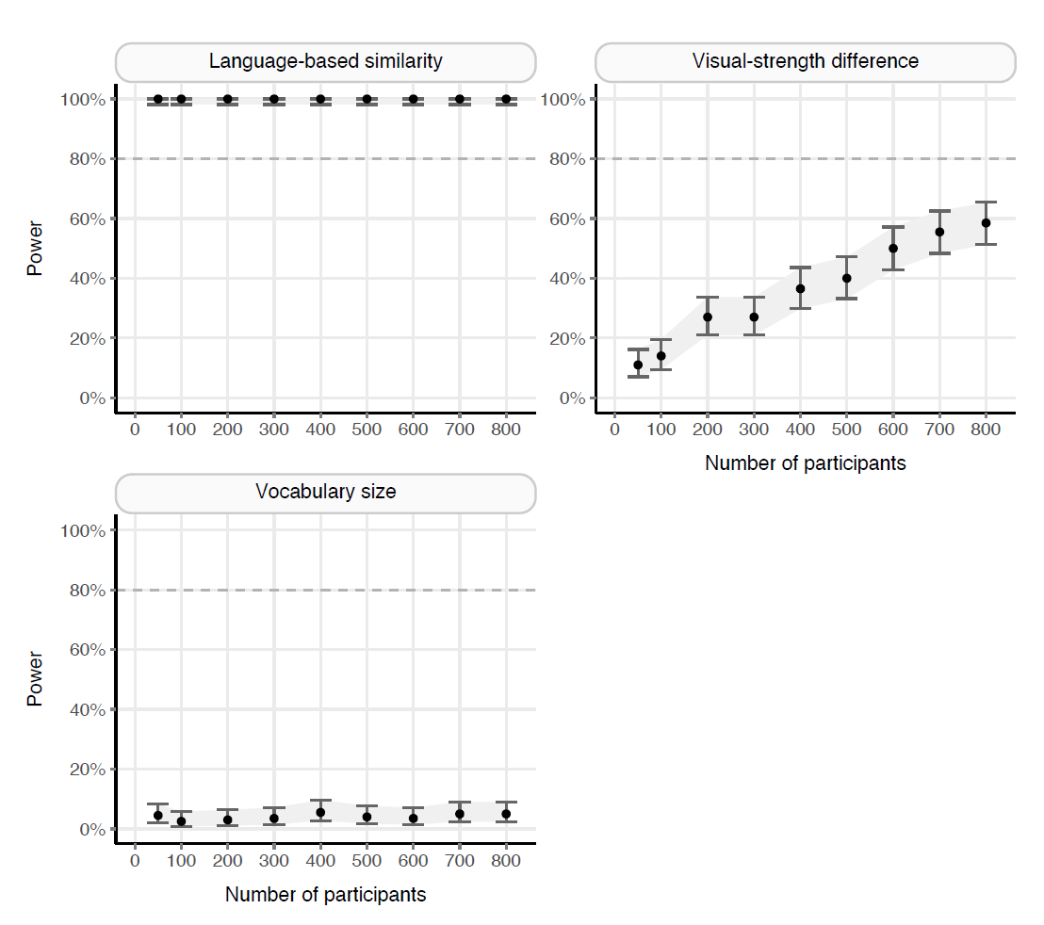

Slide 54
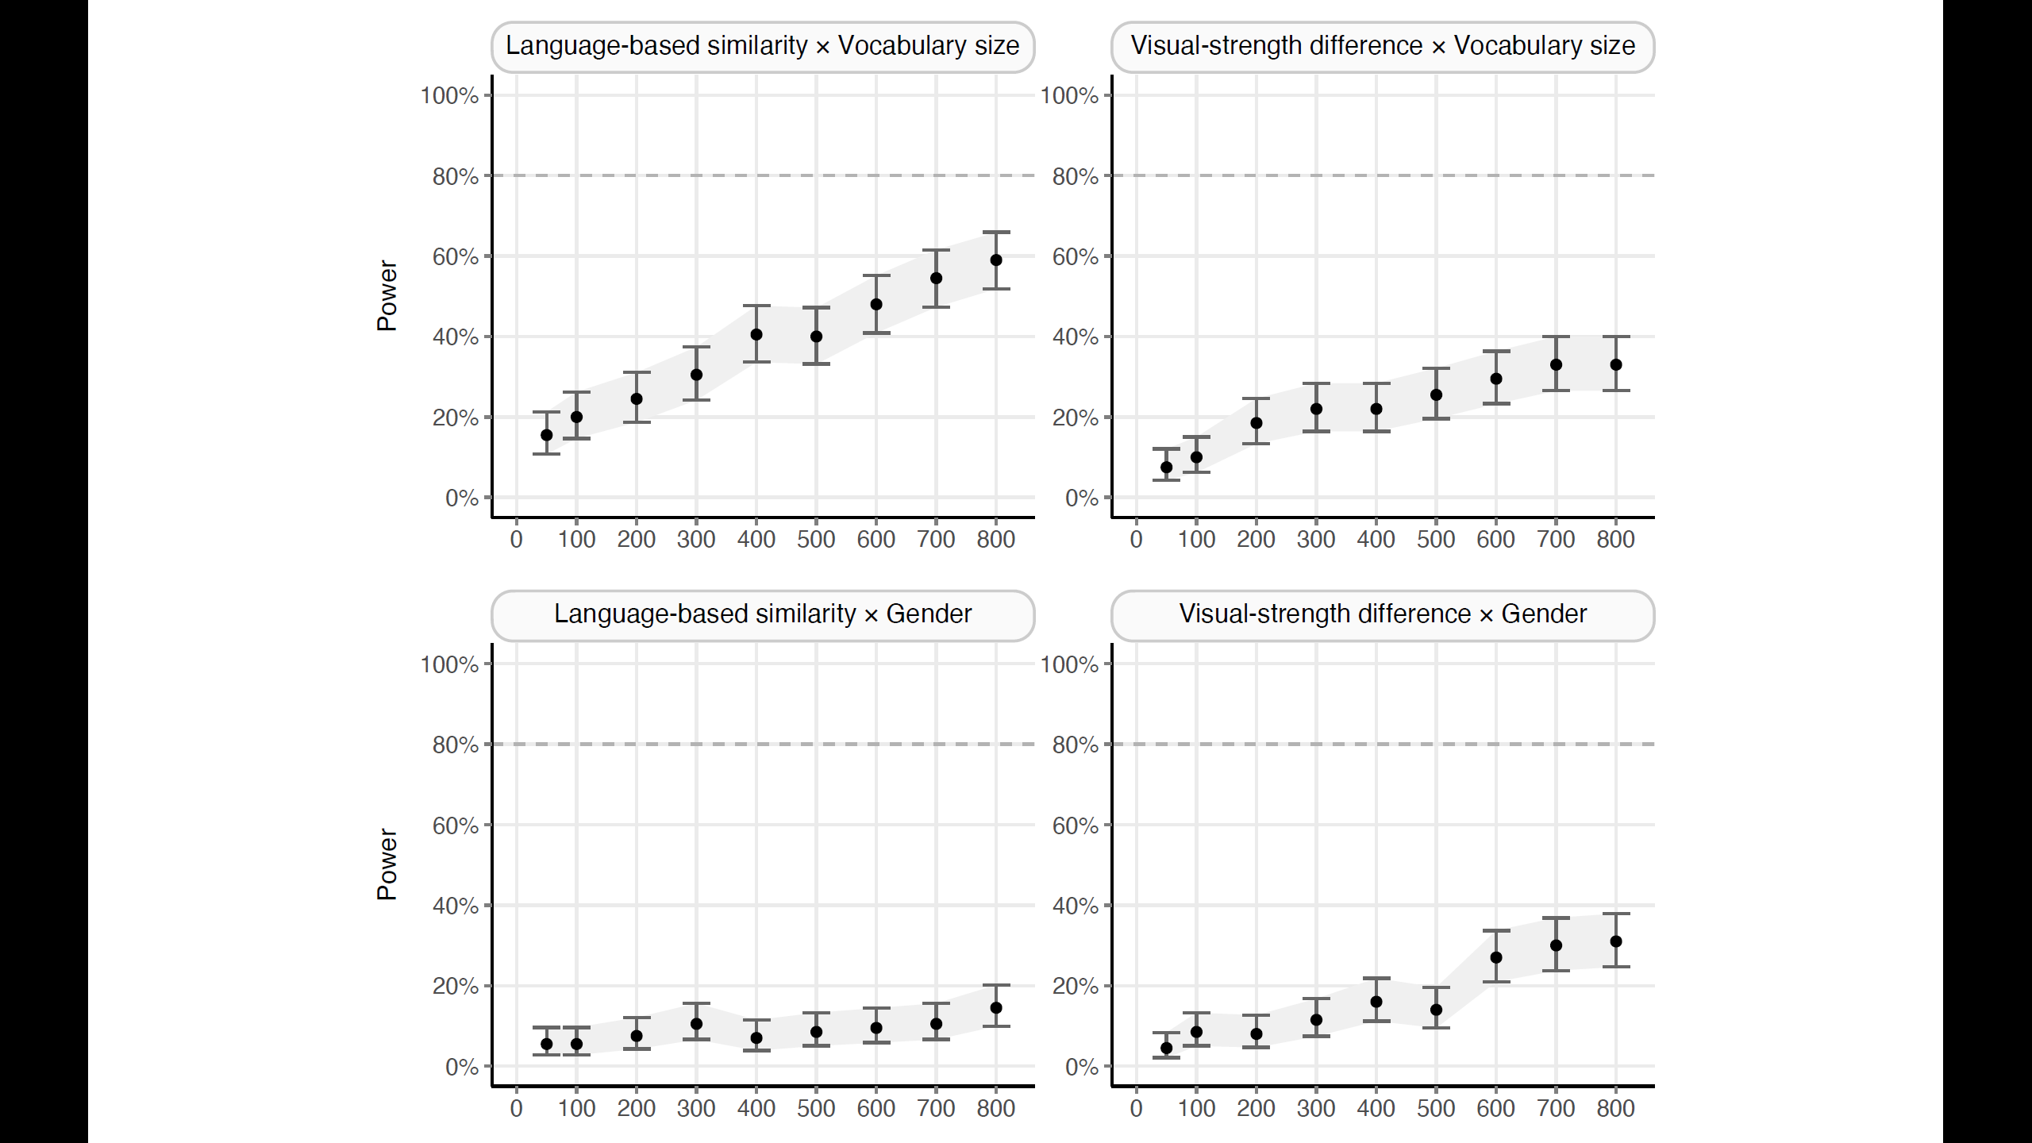

Slide 55
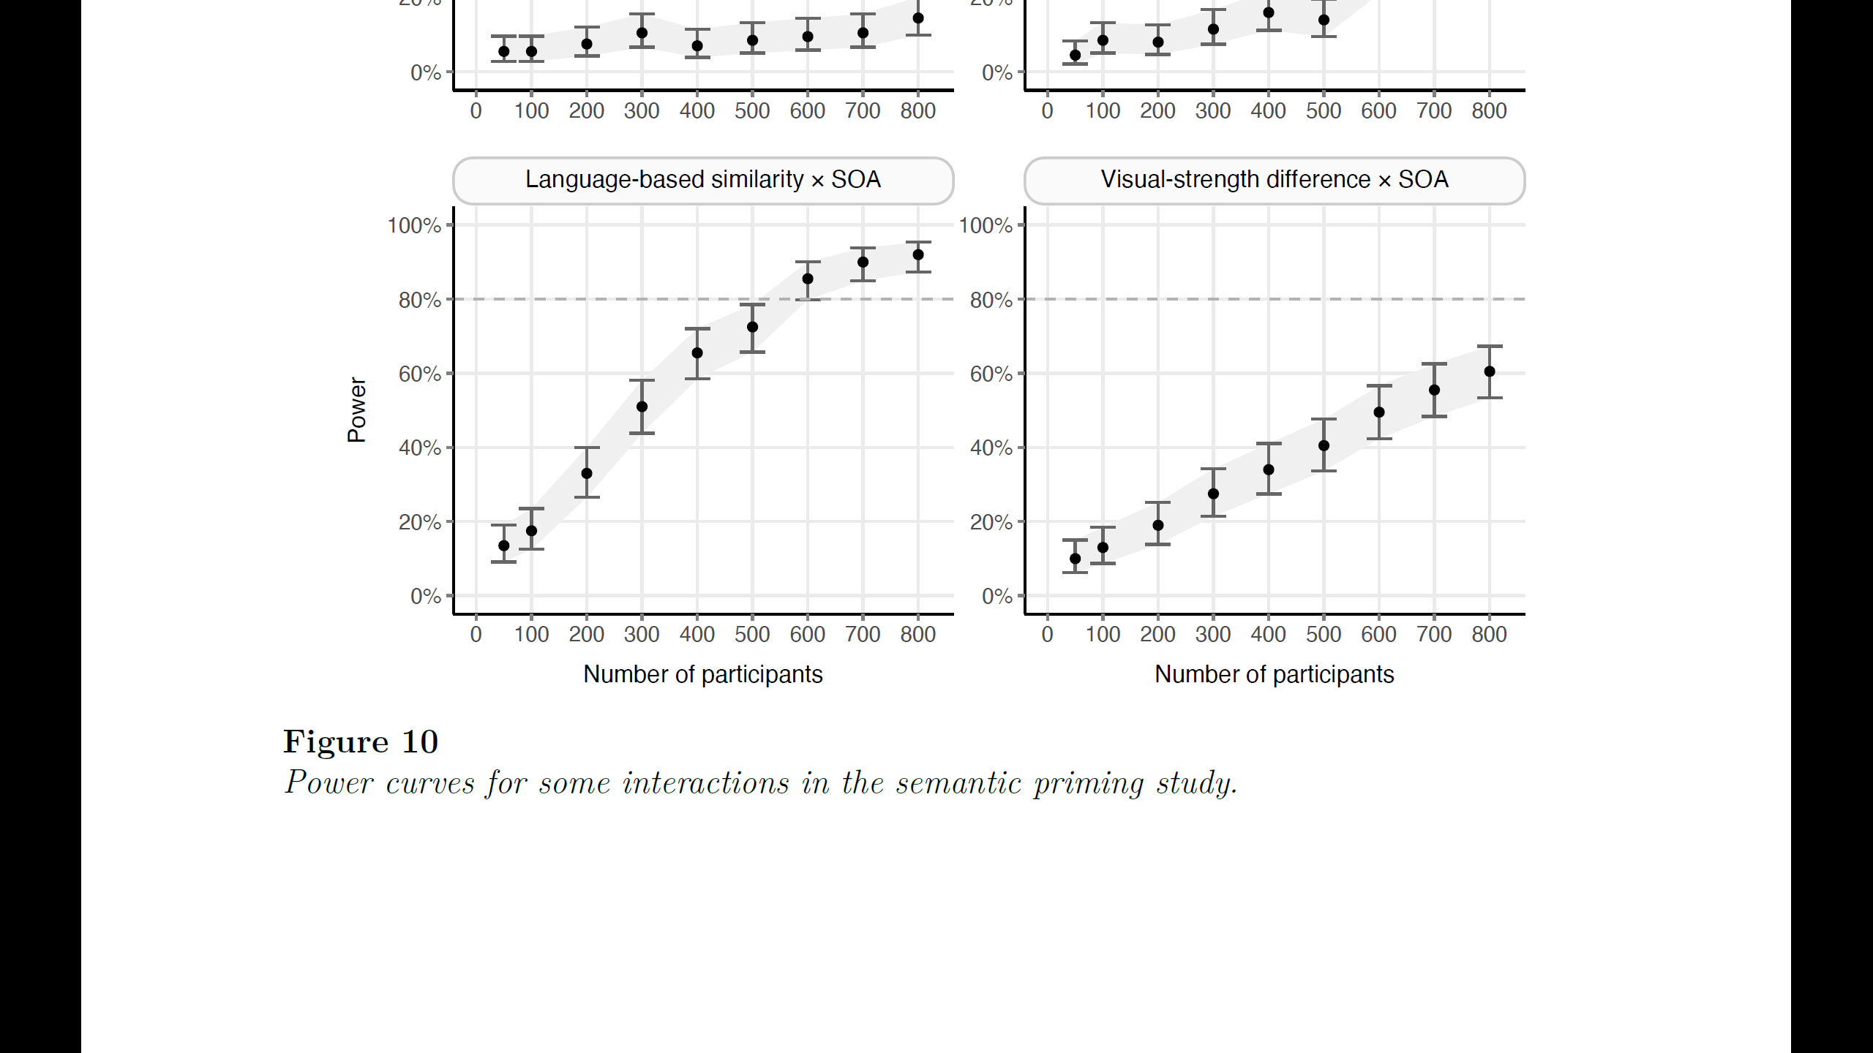

Slide 56
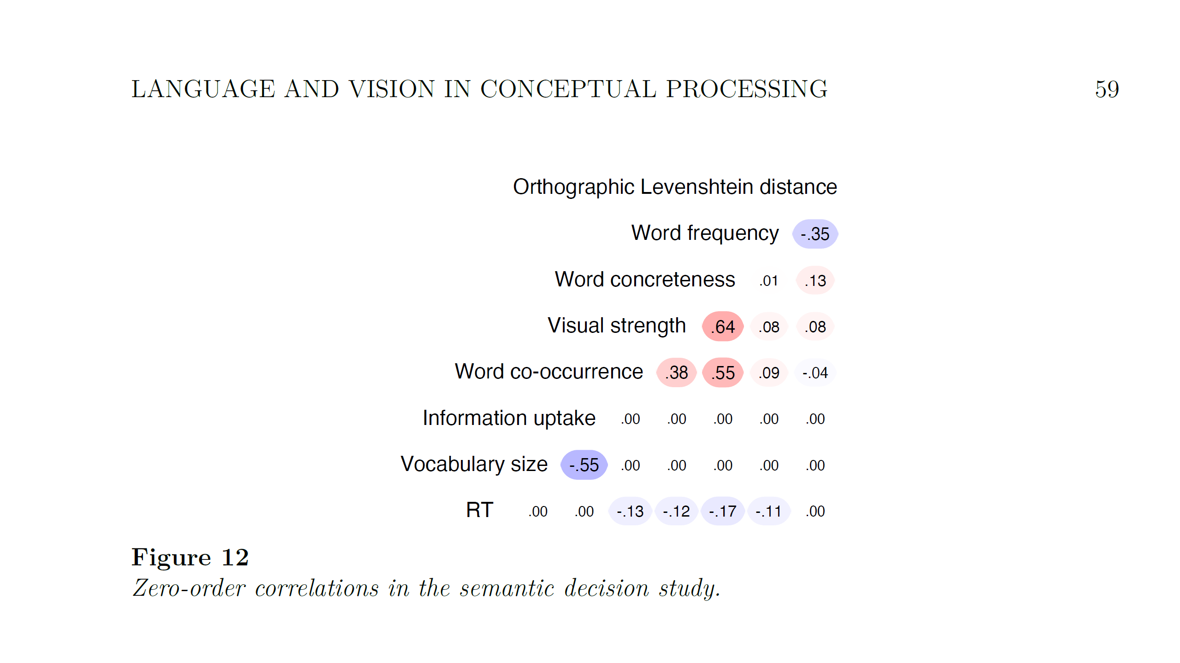

Slide 57
Differences across individual differences
Linguistic individual differences:
Higher skill → Faster RT in semantic tasks (Pexman & Yap, 2018)

Slide 58
Differences across individual differences
Linguistic individual differences:
Higher skill → Faster RT in semantic tasks (Pexman & Yap, 2018)
Sensory, motor, affective individual differences:
Higher skill → More perceptual simulation in semantic tasks
(Dils & Boroditsky, 2010)

Slide 59
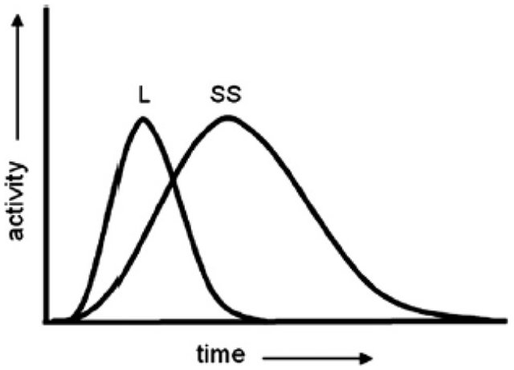
Differences across individual differences
Linguistic individual differences:
Higher skill → Faster RT in semantic tasks (Pexman & Yap, 2018)
Sensory, motor, affective individual differences:
Higher skill → More perceptual simulation in semantic tasks
(Dils & Boroditsky, 2010)
Time

Slide 60
Differences across individual differences
Linguistic individual differences:
Higher skill → Faster RT in semantic tasks (Pexman & Yap, 2018)
Sensory, motor, affective individual differences:
Higher skill → More perceptual simulation in semantic tasks
(Dils & Boroditsky, 2010)
Language
Time

Slide 61
Differences across individual differences
Linguistic individual differences: quite consistent
Higher skill → Faster RT in semantic tasks (Pexman & Yap, 2018)
Sensory, motor, affective individual differences: less consistent
Higher skill → More perceptual simulation in semantic tasks
(Dils & Boroditsky, 2010)
Language
Simulation
Time

Slide 62
Differences across individual differences
Linguistic individual differences: quite consistent
Higher skill → Faster RT in semantic tasks (Pexman & Yap, 2018)
Sensory, motor, affective individual differences: less consistent
Higher skill → More perceptual simulation in semantic tasks
(Dils & Boroditsky, 2010)
Muraki and Pexman (2021): No role of motor individual differences
Language
Simulation
Time

Slide 63
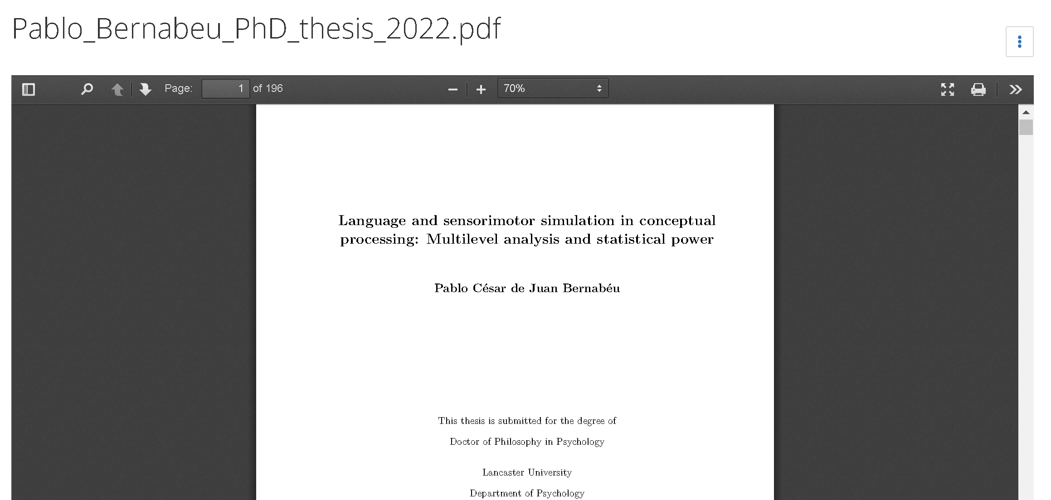
Language and sensorimotor simulation in conceptual processing: Multilevel analysis and statistical power
osf.io/97u5c

